Slide 1
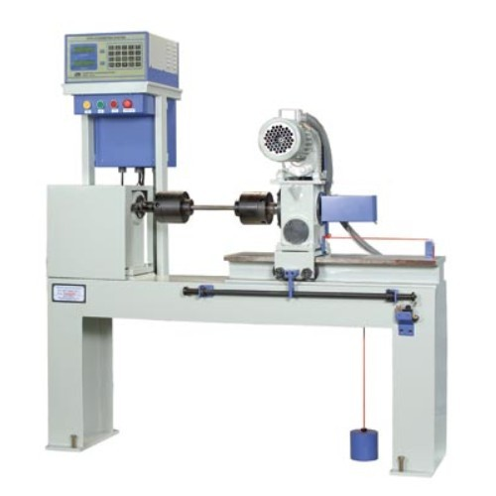
Torsion test
Torsion is the twisting of an object due to an applied torque
Torsion Testing Equipment
Shear Testing Procedure
Twisting head with chuck (one end)
Weighing head (other end) – measures the twisting moment or torque
Troptometer (twisting measuring device) – measures the deformation of the specimen

Slide 2
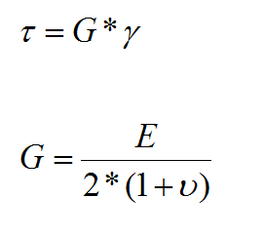
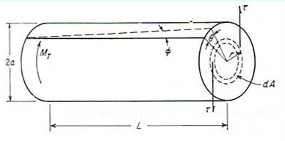
Torsion test
Ratio of shear stress to the shear strain in the elastic range is called shear modulus, or modulus of rigidity, G
G is a quantity related to the modulus of elasticity E
Considering a cylindrical bar with one end being twisted as shown in figure 1, the twisting
moment MT is resisted by the shear stress τ existing across the specimen section. This shear stress is zero at the center of the bar, increases linearly with its radius and finally reaches its maximum value at the peripheral of the bar. If the cylindrical bar with a length of L, the twisting moment can be related to the shear stress as follow
The shear strain, γ, can be calculated from equation:
Figure1 : Torsion of a solid bar

Slide 3
T = torsional moment, Nm
J is the polar moment of inertia, mm⁴ or in⁴
G is the shear modulus, N/mm² or lbf/in²
θ is degree of rotation, radian
r is the radius of the cylindrical bar, mm or in
L is the length of the cylindrical bar, mm or in
τ is the shear stress, N/mm² or lbf/in²
Within the elastic range of deformation, the shear stress can be calculated according to equation:
For a solid cylindrical specimen, the polar moment J = πD⁴/32, we can therefore determine the shear stress as shown in equation:

Slide 4
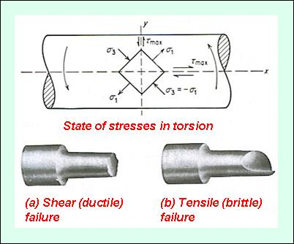
Types of torsion failures
It can be seen that the maximum shear stresses exist along two planes, which are perpendicular to each other. One is perpendicular to the longitudinal axis (yy) and another is aligned parallel to the longitudinal axis (xx).
The principle stresses σ1 and σ3 are inclined at 45º to the longitudinal axis and have their magnitudes equal to those of the shear stresses. The principle stress σ1 is tensile while the principle stress σ3 is compressive. The intermediate stress σ2 is zero under torsion.
Figure 2: Types of failure in torsion
There are two types of torsion failures:
1) Shear (ductile) failure due to the shear stresses affected by the tensile stresses
2) Tensile (brittle) failure due to the tensile stresses affected by the shear stresses

Slide 5
3

